Slide 1

2CS503 Design & Analysis of Algorithm Greedy Algorithm
Unit-3
Divide and Conquer Algorithm

Slide 2

Outline
General Characteristics of greedy algorithms
Elements of Greedy Strategy
Make change Problem
Minimum Spanning trees (Kruskal’s algorithm, Prim’s algorithm)
The Knapsack Problem
Job Scheduling Problem
Huffman code
Looping

Slide 3
Characteristics of Greedy Algorithms
Greedy : always makes the choice that seems to be the best at that moment
Greedy algorithms are characterized by the following features.
Greedy approach forms a set or list of candidates 𝑪.
Once a candidate is selected in the solution, it is there forever: once a candidate is excluded from the solution, it is never reconsidered.
To construct the solution in an optimal way, Greedy Algorithm maintains two sets.
One set contains candidates that have already been considered and chosen, while the other set contains candidates that have been considered but rejected.
The greedy algorithm consists of four functions.
Solution Function:- A function that checks whether chosen set of items provides a solution.
Feasible Function:- A function that checks the feasibility of a set.
Selection Function:- The selection function tells which of the candidates is the most promising.
Objective Function:- An objective function, which does not appear explicitly, but gives the value of a solution.

Slide 4
Coin Change Problem

Slide 5
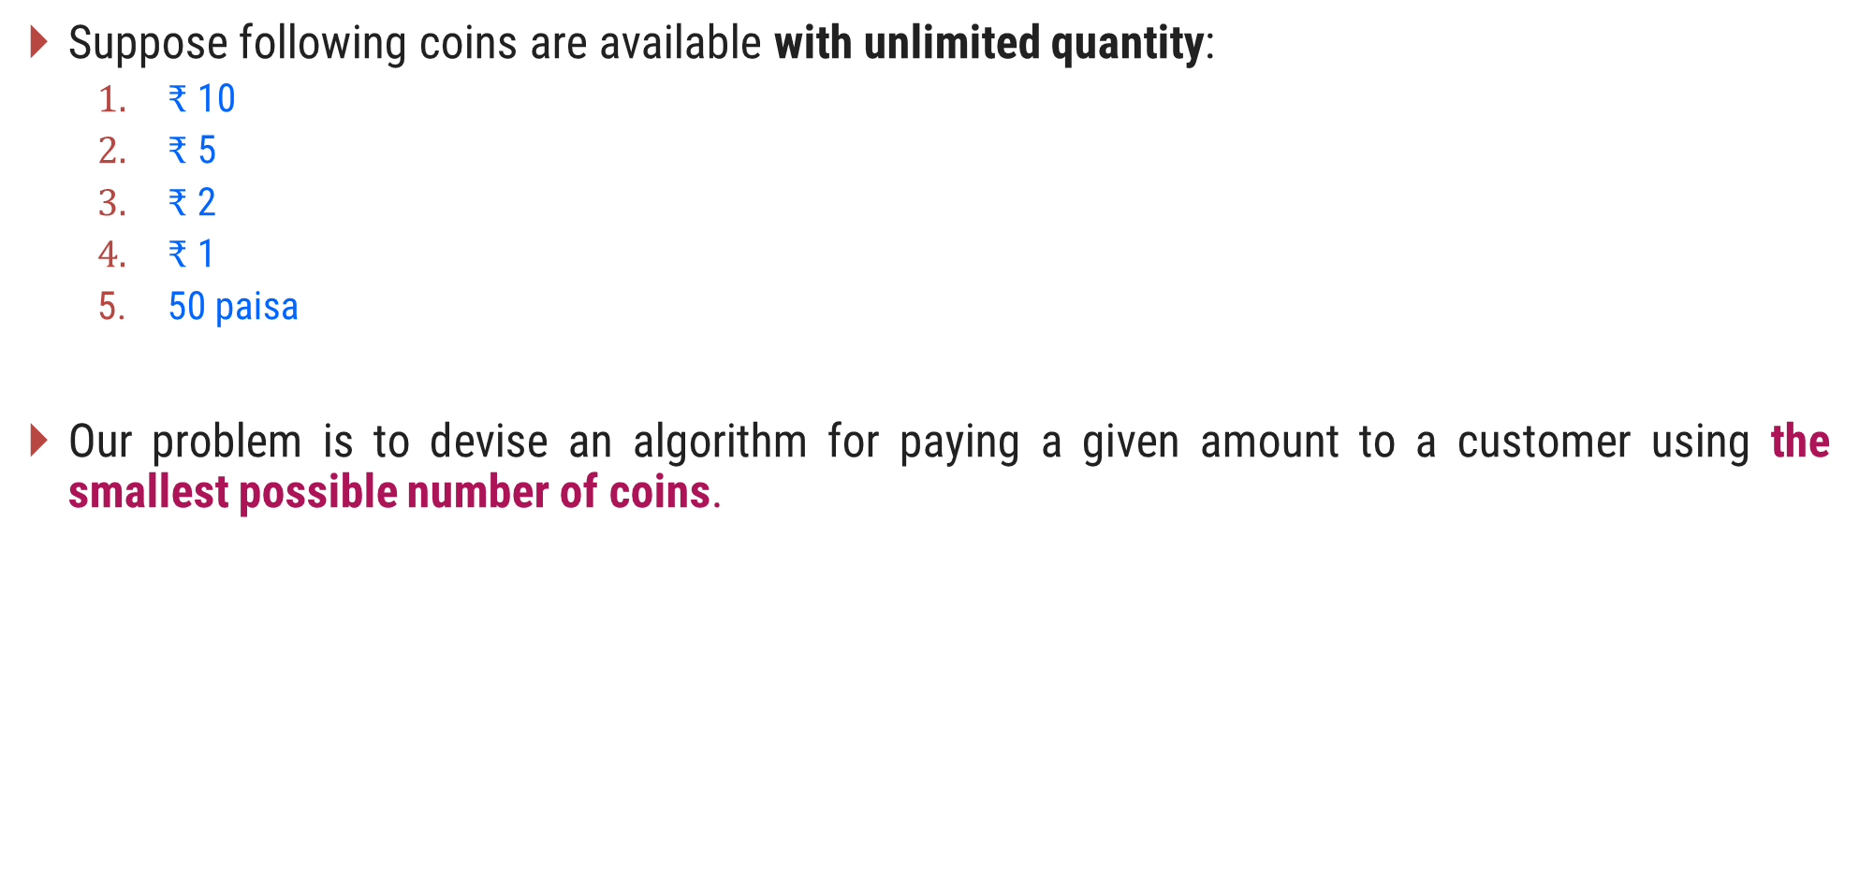
Problem Definition
Suppose following coins are available with unlimited quantity:
$₹$ 10
$₹$ 5
$₹$ 2
$₹$ 1
50 paisa
Our problem is to devise an algorithm for paying a given amount to a customer using the smallest possible number of coins.

Slide 6

Make Change – Greedy Solution
If suppose, we need to pay an amount of $₹$ 28/- using the available coins.
Here we have a candidate (coins) set $C = \{10, 5, 2, 1, 0.5\}$
The greedy solution is,
Selected coins are
Amount
Total required coins = 5
Selected coins = {10, 5, 2, 1}
coins
quantity
0
20
25
27
28
10
2
5
1
2
1
1
1

Slide 7
Make Change - Algorithm
# Input: C = {10, 5, 2, 1, 0.5} //C is a candidate set
# Output: S: set of selected coins
Function make-change(n): set of coins
S ← Ø {S is a set that will hold the solution}
sum ← 0 {sum of the items in solution set S}
while sum ≠ n do
x ← the largest item in C such that sum + x ≤ n
if there is no such item then
return "no solution found"
S ← S U {a coin of value x}
sum ← sum + x
return S

Slide 8
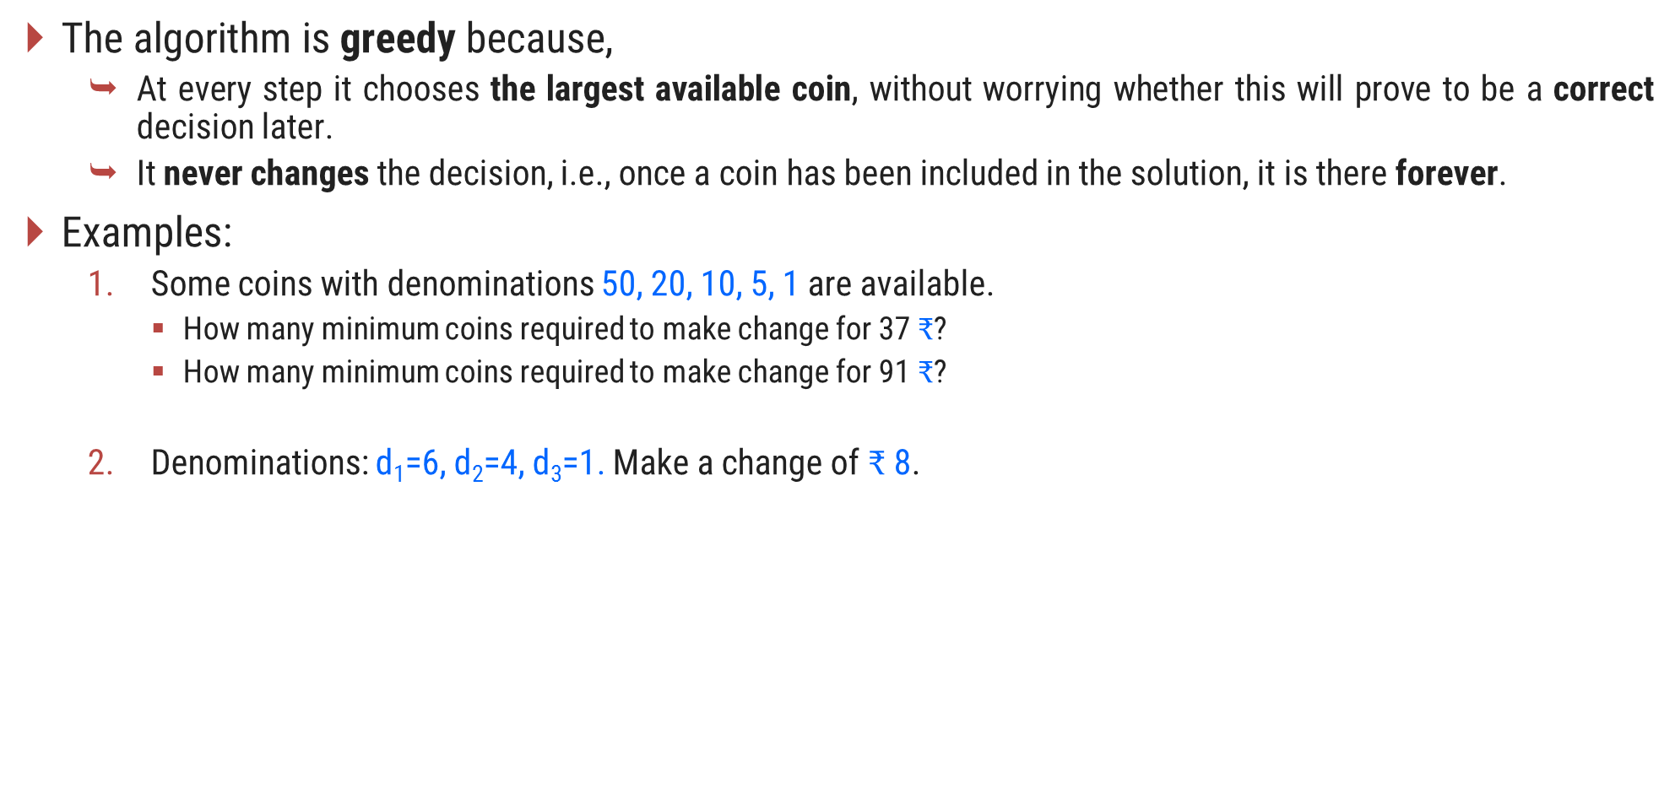
Make Change – The Greedy Property
The algorithm is greedy because,
At every step it chooses the largest available coin, without worrying whether this will prove to be a correct decision later.
It never changes the decision, i.e., once a coin has been included in the solution, it is there forever.
Examples:
Some coins with denominations 50, 20, 10, 5, 1 are available.
How many minimum coins required to make change for 37 $₹$?
How many minimum coins required to make change for 91 $₹$?
Denominations: d₁=6, d₂=4, d₃=1. Make a change of $₹$8.
5
4
3
The minimum coins required are
2

Slide 9
Knapsack Problem

Slide 10
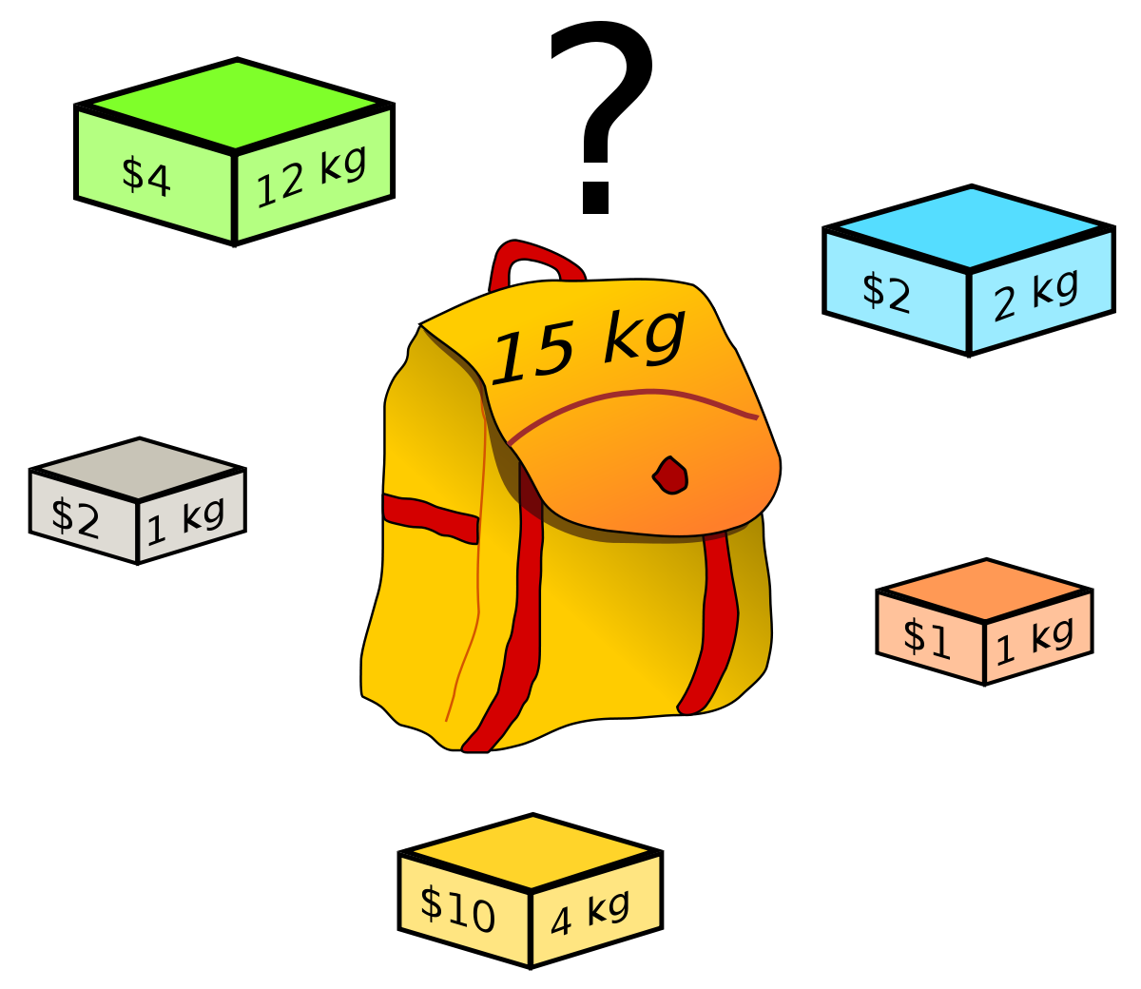
Knapsack Problem

Slide 11
Fractional Knapsack Problem

Slide 12
Introduction
We are given $n$ objects and a knapsack.
Object $i$ has a positive weight $w_{i}$and a positive value $v_{i}$ for $i = 1, 2… n.$
The knapsack can carry a weight not exceeding $W$.
Our aim is to fill the knapsack in a way that maximizes the value of the included objects, while respecting the capacity constraint.
In a fractional knapsack problem, we assume that the objects can be broken into smaller pieces.
So we may decide to carry only a fraction $x_{i}$of object $i$, where $0≤x_{i}≤1.$
In this case, object $i$ contribute $x_{i}w_{i}$ to the total weight in the knapsack, and $x_{i}v_{i}$ to the value of the load.
Symbolic Representation of the problem can be given as follows:
maximize $\sum_{i=1}^{n}{x\text{i}}v\text{i}$ subject to $\sum_{i=1}^{n}{x\text{i}}w\text{i}$ $≤W$
Where$, v_{i}>0$, $wi>0$and $0≤x_{i}≤1$for $1≤ i≤n$.

Slide 13
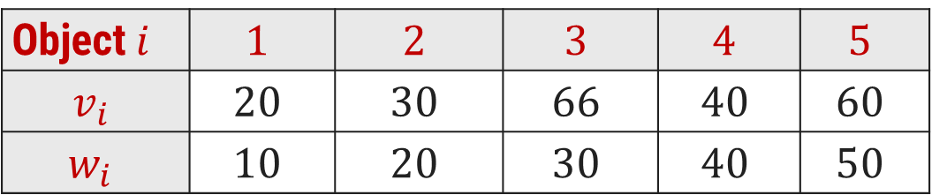
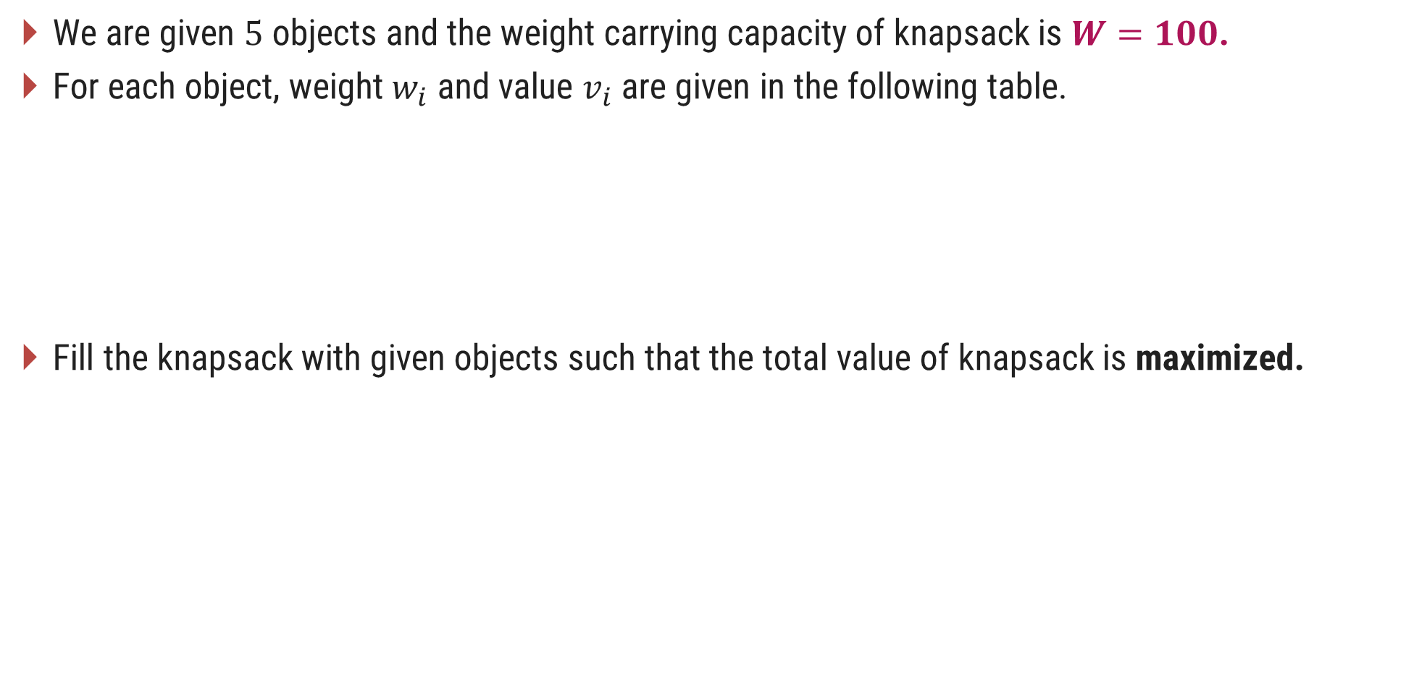
Fractional Knapsack Problem - Example
We are given $5$ objects and the weight carrying capacity of knapsack is $W=100$.
For each object, weight $w_{i}$ and value $v_{i}$are given in the following table.
Fill the knapsack with given objects such that the total value of knapsack is maximized.
Object$i$ | $$1$$ | $$2$$ | $$3$$ | $$4$$ | $$5$$
$$v_{i}$$ | $$20$$ | $$30$$ | $$66$$ | $$40$$ | $$60$$
$$w_{i}$$ | $$10$$ | $$20$$ | $$30$$ | $$40$$ | $$50$$

Slide 14
Fractional Knapsack Problem - Greedy Solution
Three Selection Functions can be defined as,
Sort the items in descending order of their values and select the items till weight criteria is satisfied.
Sort the items in ascending order of their weight and select the items till weight criteria is satisfied.
To calculate the ratio value/weight for each item and sort the item on basis of this ratio. Then take the item with the highest ratio and add it.

Slide 15
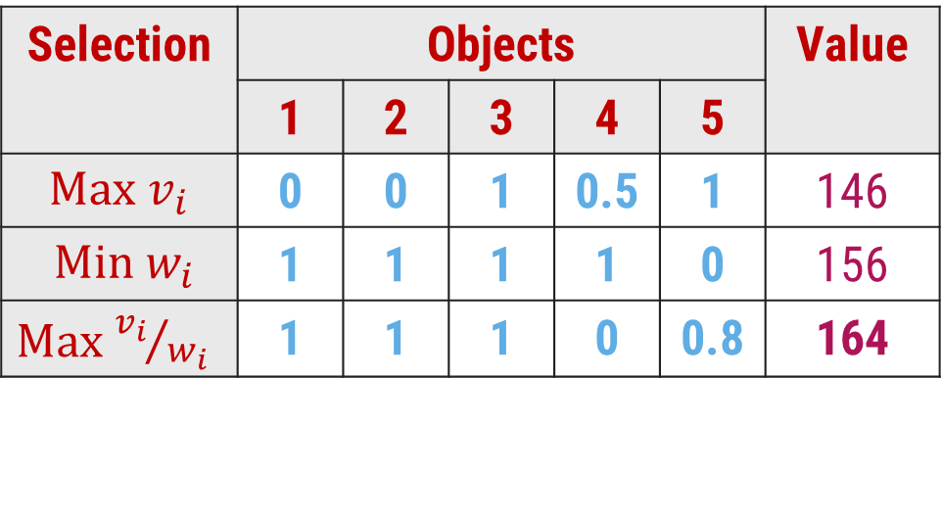
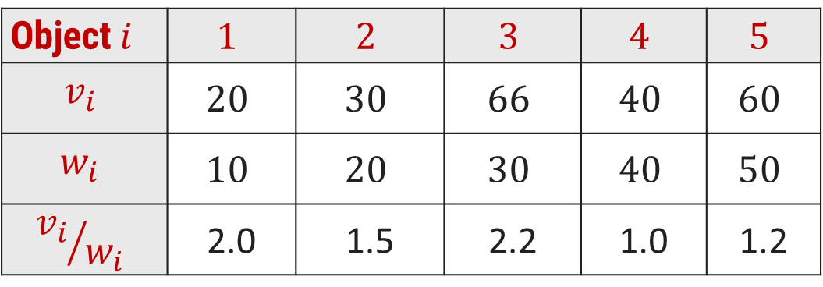
Fractional Knapsack Problem - Greedy Solution
Object$i$ | $$1$$ | $$2$$ | $$3$$ | $$4$$ | $$5$$
$$v_{i}$$ | $$20$$ | $$30$$ | $$66$$ | $$40$$ | $$60$$
$$w_{i}$$ | $$10$$ | $$20$$ | $$30$$ | $$40$$ | $$50$$
$${v_{i}}/{w_{i}}$$ | 2.0 | 1.5 | 2.2 | 1.0 | 1.2
Selection | Objects |  |  |  |  | Value
 | 1 | 2 | 3 | 4 | 5
$\text{Max}$ $v_{i}$ | 0 | 0 | 1 | 0.5 | 1 | 146
$\text{Min} w_{i}$ | 1 | 1 | 1 | 1 | 0 | 156
$\text{Max}$ ${v_{i}}/{w_{i}}$ | 1 | 1 | 1 | 0 | 0.8 | 164
Weight Capacity 100
30
50
20
10
20
30
40
30
10
20
40
Profit = 66 + 20 + 30 + 48 = 164
Profit = 66 + 60 + (40 * 0.5) = 146
Profit = 20 + 30 + 66 + 40 = 156

Slide 16
Fractional Knapsack Problem - Algorithm
Algorithm: Greedy-Fractional-Knapsack (w[1..n], p[1..n], W)
for i = 1 to n do
x[i] $←$ 0 ; weight $←$ 0
While weight < W do
i $←$ the best remaining object
if weight + w[i] ≤ W then
x[i] $←$1
weight $←$ weight + w[i]
else
x[i] $←$ (W - weight) / w[i]
weight $←$ W
return x
W = 100 and Current weight in knapsack= 60
Object weight = 50
The fraction of object to be included will be
(100 – 60) / 50 = 0.8

Slide 17
Exercises – Home Work
Consider Knapsack capacity $W=50$, $w = (10, 20, 40)$and $v = (60, 80,100)$find the maximum profit using greedy approach.
Consider Knapsack capacity $W = 10$, $w=(4, 8, 2, 6, 1)$and $v = (12, 32, 40, 30, 50)$. Find the maximum profit using greedy approach.

Slide 18
Activity Selection Problem

Slide 19
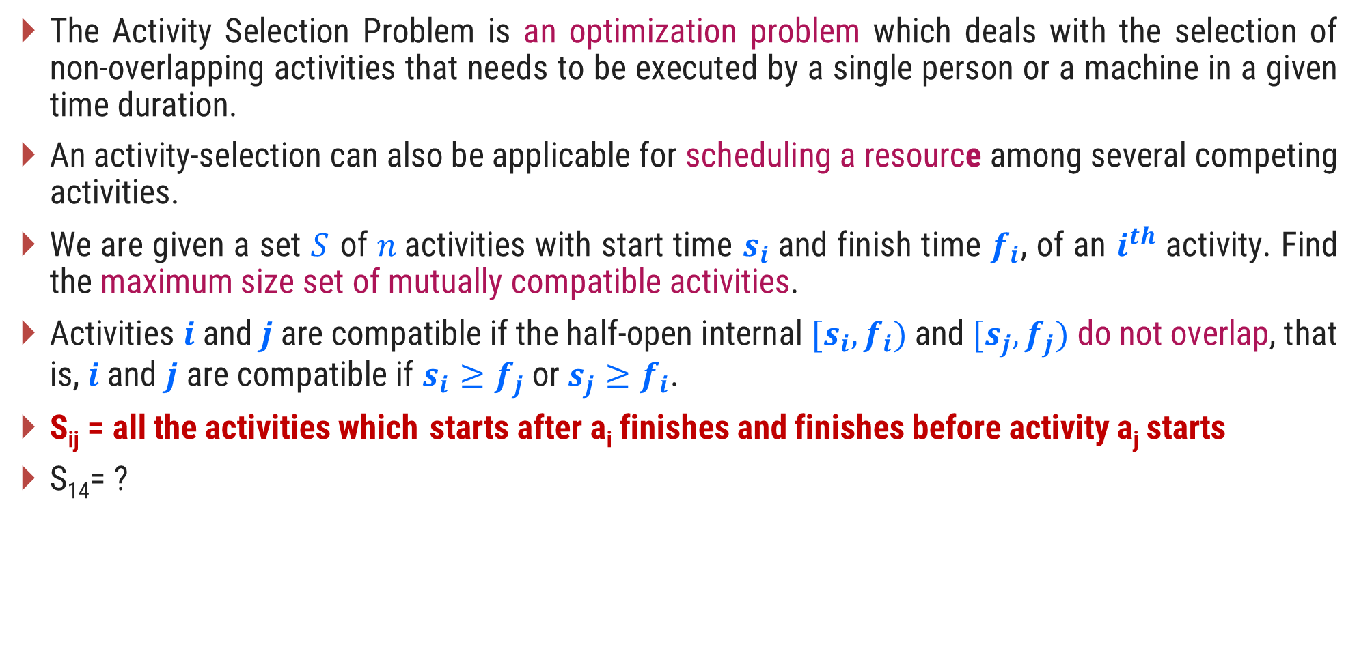
Introduction
The Activity Selection Problem is an optimization problem which deals with the selection of non-overlapping activities that needs to be executed by a single person or a machine in a given time duration.
An activity-selection can also be applicable for scheduling a resource among several competing activities.
We are given a set $S$ of $n$activities with start time $s_{i}$and finish time $f_{i}$, of an $i^{th}$ activity. Find the maximum size set of mutually compatible activities.
Activities $i$ and$j$are compatible if the half-open internal $[s_{i},f_{i})$and $[s_{j},f_{j})$do not overlap, that is, $i$ and $j$ are compatible if $s_{i}≥f_{j}$ or $s_{j}≥f_{i}$.
S_{ij} = all the activities which starts after a_{i} finishes and finishes before activity a_{j} starts
S₁₄= ?

Slide 20
Activity Selection Problem - Example
Example: 11 activities are given as,
Solution:
Step 1:
Sort the activities of set 𝑺 as per increasing finish time to directly identify mutually compatible activities by comparing finish time of first activity and start time of next activity
Sr. | Activity | ($s_{i}$, $f_{i}$)
1 | P | (1, 4)
2 | Q | (3, 5)
3 | R | (0, 6)
4 | S | (5, 7)
5 | T | (3, 8)
6 | U | (5, 9)
7 | V | (6, 10)
8 | W | (8, 11)
9 | X | (8, 12)
10 | Y | (2, 13)
11 | Z | (12, 14)

Slide 21
Activity Selection Problem - Example
Example: 11 activities are given as,
Solution:
Step 2:
A = {P}
A = {P, S}
A = {P, S, W}
A = {P, S, W, Z}
Answer: A = {P, S, W, Z}
Sr. | Activity | ($s_{i}$, $f_{i}$)
1 | P | (1, 4)
2 | Q | (3, 5)
3 | R | (0, 6)
4 | S | (5, 7)
5 | T | (3, 8)
6 | U | (5, 9)
7 | V | (6, 10)
8 | W | (8, 11)
9 | X | (8, 12)
10 | Y | (2, 13)
11 | Z | (12, 14)

Slide 22
Example:
a1 a2 a3 a4 a5 a6
S_{i}
F_{i}
1 | 2 | 3 | 4 | 5 | 6
4 | 3 | 5 | 6 | 9 | 8

Slide 23
Activity Selection - Algorithm
Algorithm: Activity Selection
Step I: Sort the input activities by increasing finishing time. f₁ ≤ f₂ ≤ . . . ≤ f_{n}
Step II: Call GREEDY-ACTIVITY-SELECTOR (s, f)
n = length [s]
A = {i}
j = 1
for i = 2 to n
do if s_{i} ≥ f_{j}
then A = A U {i}
j = i
return set A

Slide 24
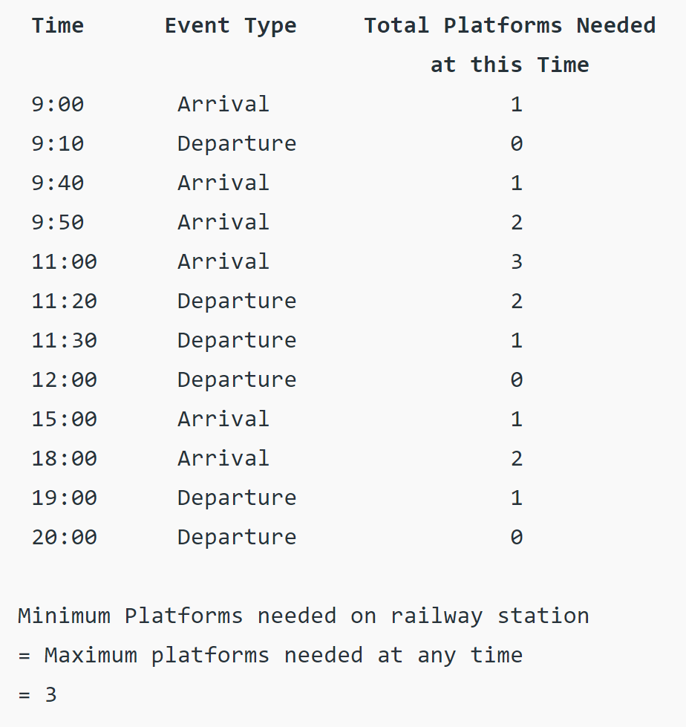
Exercise - HW
Given arrival and departure times of all trains that reach a railway station, find the minimum number of platforms required for the railway station so that no train waits. We are given two arrays which represent arrival and departure times of trains that stop. Arr[ ] = {9:00, 9:40, 9:50, 11:00, 15:00, 18:00} dep[ ] = {9:10, 12:00, 11:20, 11:30, 19:00, 20:00}

Slide 25
Job Scheduling with Deadlines

Slide 26
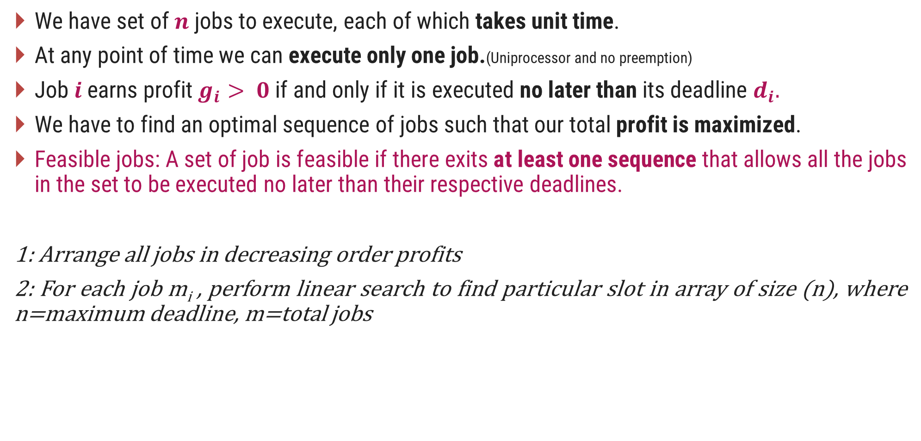
Introduction
We have set of $n$ jobs to execute, each of which takes unit time.
At any point of time we can execute only one job.(Uniprocessor and no preemption)
Job$i$earns profit $g_{i}> 0$if and only if it is executed no later than its deadline $d_{i}.$
We have to find an optimal sequence of jobs such that our total profit is maximized.
Feasible jobs: A set of job is feasible if there exits at least one sequence that allows all the jobs in the set to be executed no later than their respective deadlines.
1: Arrange all jobs in decreasing order profits
2: For each job m_{i} , perform linear search to find particular slot in array of size (n), where n=maximum deadline, m=total jobs

Slide 27
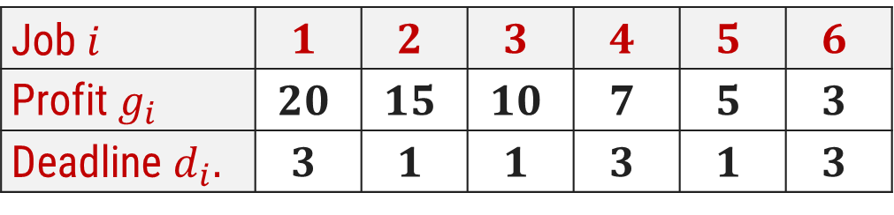

Job Scheduling with Deadlines - Example
Using greedy algorithm find an optimal schedule for following jobs with $n=6$.
Profits: $(P_{1},P_{2},P_{3},P_{4},P_{5},P_{6}) = (15,20,10,7,5,3)$&
Deadline: $(d_{1},d_{2},d_{3},d_{4},d_{5},d_{6}) = (1, 3, 1, 3, 1, 3)$
Solution:
Sort the jobs in decreasing order of their profit.
Step 1:
Job $i$ | $$1$$ | $$2$$ | $$3$$ | $$4$$ | $$5$$ | $$6$$
Profit $g_{i}$ | $$20$$ | $$15$$ | $$10$$ | $$7$$ | $$5$$ | $$3$$
Deadline $d_{i}.$ | $$3$$ | $$1$$ | $$1$$ | $$3$$ | $$1$$ | $$3$$

Slide 28
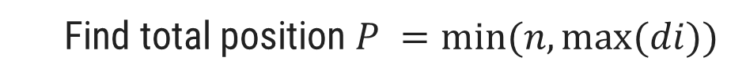
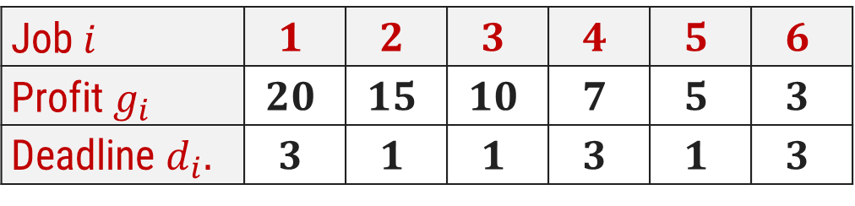
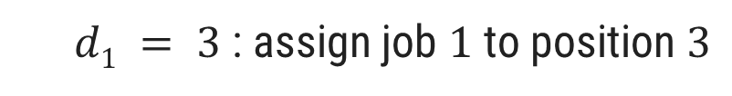
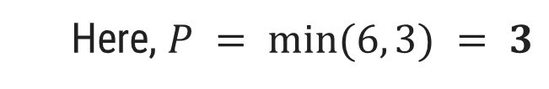
Job Scheduling with Deadlines - Example
Job $i$ | $$1$$ | $$2$$ | $$3$$ | $$4$$ | $$5$$ | $$6$$
Profit $g_{i}$ | $$20$$ | $$15$$ | $$10$$ | $$7$$ | $$5$$ | $$3$$
Deadline $d_{i}.$ | $$3$$ | $$1$$ | $$1$$ | $$3$$ | $$1$$ | $$3$$
Step 2:
Find total position $P =min⁡(n, max⁡(di))$
Here, $P = min⁡(6, 3) = 3$
P
1
2
3
Job selected
0
0
0
Step 3:
$d1 = 3$: assign job $1$ to position $3$
P
1
2
3
Job selected
0
0
J1

Slide 29
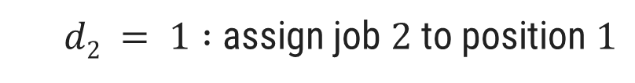
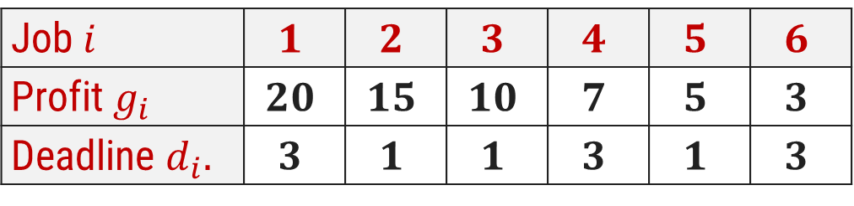
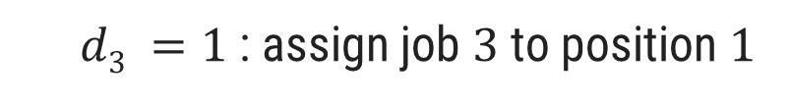
Job Scheduling with Deadlines - Example
Job $i$ | $$1$$ | $$2$$ | $$3$$ | $$4$$ | $$5$$ | $$6$$
Profit $g_{i}$ | $$20$$ | $$15$$ | $$10$$ | $$7$$ | $$5$$ | $$3$$
Deadline $d_{i}.$ | $$3$$ | $$1$$ | $$1$$ | $$3$$ | $$1$$ | $$3$$
Step 4:
$d2 = 1 :$assign job $2$ to position $1$
P
1
2
3
Job selected
J2
0
J1
Step 5:
$d3 =1$: assign job $3$ to position $1$
But position 1 is already occupied and two jobs can not be executed in parallel, so reject job 3

Slide 30
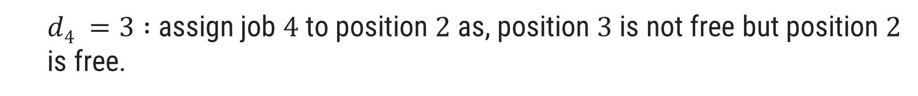
Job Scheduling with Deadlines - Example
Job $i$ | $$1$$ | $$2$$ | $$3$$ | $$4$$ | $$5$$ | $$6$$
Profit $g_{i}$ | $$20$$ | $$15$$ | $$10$$ | $$7$$ | $$5$$ | $$3$$
Deadline $d_{i}.$ | $$3$$ | $$1$$ | $$1$$ | $$3$$ | $$1$$ | $$3$$
Step 6:
$d4 =3 :$assign job $4$ to position $2$as, position $3$ is not free but position $2$ is free.
P
1
2
3
Job selected
J2
J4
J1
Now no more free position is left so no more jobs can be scheduled.
The final optimal sequence:
Execute the job in order 2, 4, 1 with total profit value 42.

Slide 31
Exercises – Home Work
Using greedy algorithm find an optimal schedule for following jobs with 𝒏=4.
Profits: (a, b, c, d) = (20,10,40,30) &
Deadline: (d₁, d₂, d₃, d₄) = (4, 1, 1, 1)
Using greedy algorithm find an optimal schedule for following jobs with 𝒏=5.
Profits: (a, b, c, d, e) = (100,19,27,25,15) &
Deadline: (d₁, d₂, d₃, d₄, d₅) = (2, 1, 2, 1, 3)

Slide 32
Job Scheduling with Deadlines - Algorithm
Algorithm: Job-Scheduling (P[1..n], D[1..n])
Sort all the n jobs in decreasing order of their profit.
Let total position P = min(n, max(d_{i}))
Each position 0, 1, 2…, P is in different set and T({i}) = i, for 0 ≤ i ≤ P.
Find the set that contains d, let this set be K. if T(K) = 0 reject the job; otherwise:
Assign the new job to position T(K).
Find the set that contains T(K) – 1. Call this set L.
Merge K and L. the value for this new set is the old value of T(L).

Slide 33
Huffman Codes

Slide 34
Prefix Code
Prefix code is used for encoding(compression) and Decoding(Decompression).
Prefix Code: Any code that is not prefix of another code is called prefix code.
Characters | Frequency | Code | Bits
a | 45 | 000 | 135
b | 13 | 111 | 39
c | 12 | 101 | 36
d | 16 | 110 | 48
e | 9 | 011 | 27
f | 5 | 001 | 5
Total bits |  |  | 290

Slide 35
Huffman code Introduction
Huffman Coding is a technique of compressing data to reduce its size without losing any of the details. It was first developed by David Huffman.
Huffman Coding is generally useful to compress the data where character comes frequently.
Huffman invented a greedy algorithm that constructs an optimal prefix code called a Huffman code.
Huffman coding is a lossless data compression algorithm.
It assigns variable-length codes to input characters.
Lengths of the assigned codes are based on the frequencies of corresponding characters.
The most frequent character gets the smallest code and the least frequent character gets the largest code.
The variable-length codes assigned to input characters are Prefix Codes.

Slide 36
Huffman Codes
In Prefix codes, the codes are assigned in such a way that the code assigned to one character is not a prefix of code assigned to any other character.
For example,
This is how Huffman Coding makes sure that there is no ambiguity when decoding the generated bit stream.
There are mainly two major parts in Huffman Coding
Build a Huffman Tree from input characters.
Traverse the Huffman Tree and assign codes to characters.
a = 01, b = 010 and c = 11
Not a prefix code

Slide 37
Huffman Codes - Example
Find the Huffman codes for the following characters.
Characters | a | b | c | d | e | f
Frequency (in thousand) | 45 | 13 | 12 | 16 | 9 | 5
Step 1:
Arrange the characters in the Ascending order of their frequency.
f:5
e:9
c:12
b:13
d:16
a:45

Slide 38
Huffman Codes - Example
Step 2:
Extract two nodes with the minimum frequency.
Create a new internal node with frequency equal to the sum of the two nodes frequencies.
Make the first extracted node as its left child and the other extracted node as its right child.
14
f:5
e:9
c:12
b:13
d:16
a:45

Slide 39
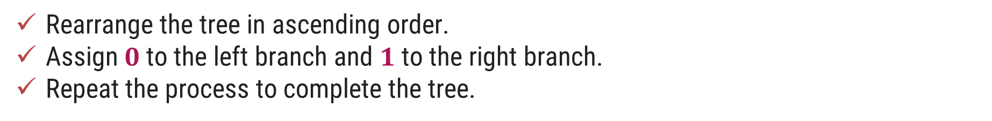
Huffman Codes - Example
Step 3:
Rearrange the tree in ascending order.
Assign $0$to the left branch and $1$to the right branch.
Repeat the process to complete the tree.
14
f:5
e:9
c:12
b:13
d:16
a:45
0
1

Slide 40
Huffman Codes - Example
25
Step 4:
c:12
b:13
14
d:16
a:45
0
1
f:5
e:9
14
d:16
25
a:45
0
1
0
1
f:5
e:9
c:12
b:13

Slide 41
Huffman Codes - Example
30
Step 5:
14
25
a:45
d:16
0
1
0
1
f:5
e:9
c:12
b:13
25
30
a:45
0
1
0
1
14
d:16
c:12
b:13
0
1
f:5
e:9

Slide 42
Huffman Codes - Example
Step 6:
55
0
1
25
30
a:45
0
1
0
1
14
d:16
c:12
b:13
0
1
f:5
e:9

Slide 43
Huffman Codes - Example
100
Step 7:
0
1
a:45
55
0
1
25
30
0
1
0
1
14
d:16
c:12
b:13
0
1
f:5
e:9

Slide 44
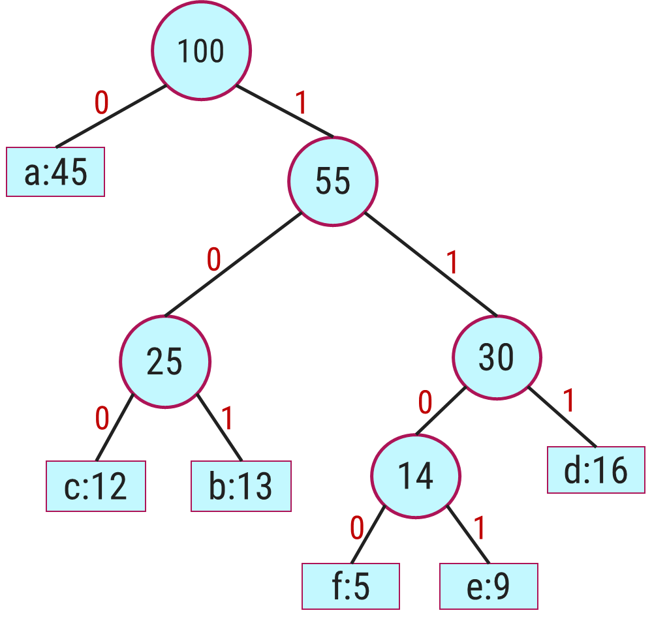
Huffman Codes - Example
Characters | a | b | c | d | e | f
Frequency (in thousand) | 45 | 13 | 12 | 16 | 9 | 5
Step 8:
0
101
100
111
1101
1100
Total bits: 224

Slide 45
Huffman Codes - Algorithm
Algorithm: HUFFMAN (C)
create a priority queue Q consisting of each unique character.
sort then in ascending order of their frequencies
n = |C|
Q = C
for i = 1 to n-1
allocate a new node z
z.left = x = EXTRACT-MIN(Q)
z.right = y = EXTRACT-MIN(Q)
z.freq = x.freq + y.freq
INSERT(Q,z)
return EXTRACT-MIN(Q) // return the root of the tree

Slide 46
Exercises – Home Work
Find an optimal Huffman code for the following set of frequency.
a : 50, b : 20, c : 15, d : 30.
Frequency
Frequency
Characters | A | B | C | D | E | F
Frequency (in thousand) | 24 | 12 | 10 | 8 | 8 | 5
Characters | a | b | c | d | e | f | g
Frequency (in thousand) | 37 | 28 | 29 | 13 | 30 | 17 | 6

Slide 47
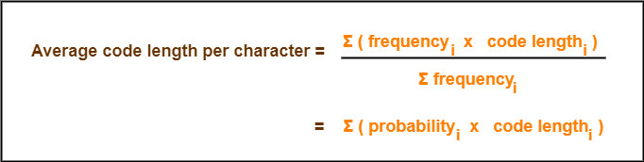
Total number of bits in Huffman encoded message
= Total number of characters in the message x Average code length per character
= ∑ ( frequency_{i} x Code length_{i} )

Slide 48
1. Huffman Code For Characters-
To write Huffman Code for any character, traverse the Huffman Tree from root node to the leaf node of that character.
Following this rule, the Huffman Code for each character is-
a = 111
e = 10
i = 00
o = 11001
u = 1101
s = 01
t = 11000
From here, we can observe-
Characters occurring less frequently in the text are assigned the larger code.
Characters occurring more frequently in the text are assigned the smaller code.

Slide 49
2. Average Code Length-
Using formula-01, we have-
Average code length
= ∑ ( frequency_{i} x code length_{i} ) / ∑ ( frequency_{i} )
= { (10 x 3) + (15 x 2) + (12 x 2) + (3 x 5) + (4 x 4) + (13 x 2) + (1 x 5) } / (10 + 15 + 12 + 3 + 4 + 13 + 1)
= 2.52
3. Length of Huffman Encoded Message-
Using formula-02, we have-
Total number of bits in Huffman encoded message
= Total number of characters in the message x Average code length per character
= 58 x 2.52
= 146.16
≅ 147 bits

Slide 50
Minimum Spanning Tree

Slide 51
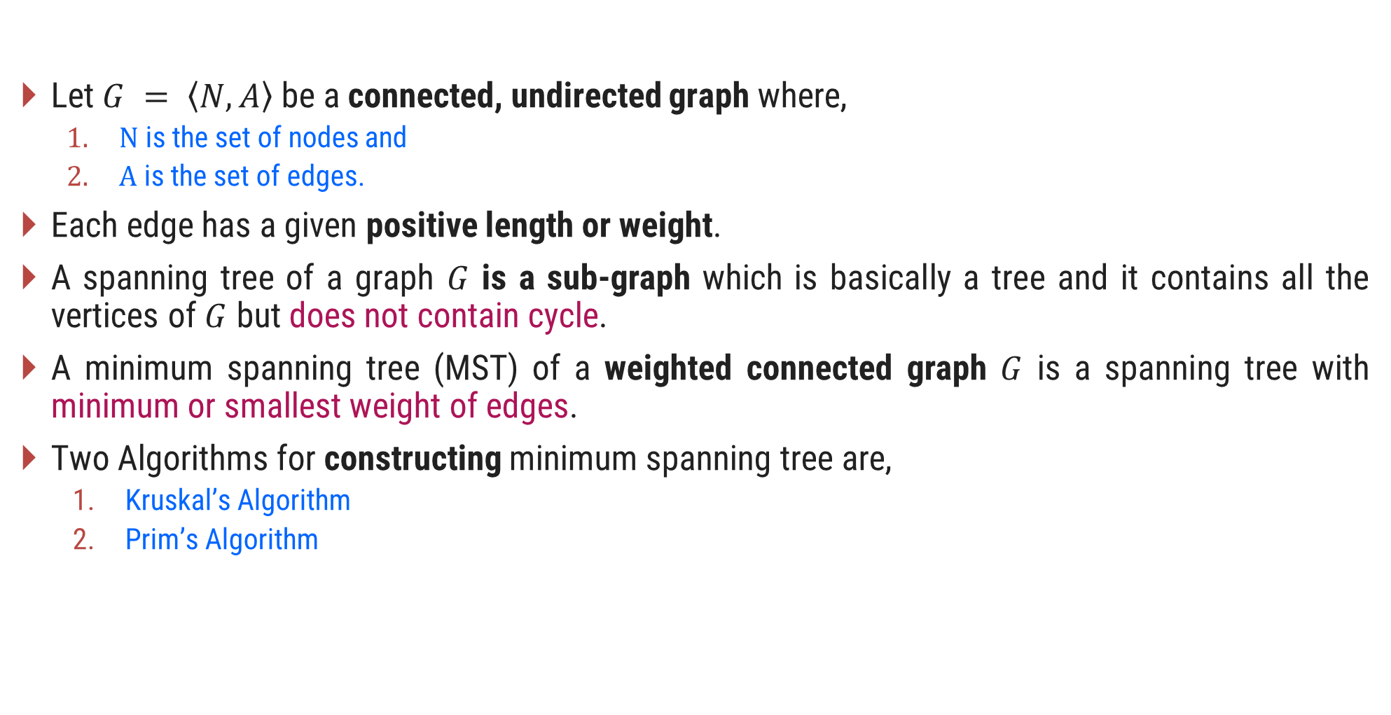
Introduction to Minimum Spanning Tree (MST)
Let $G = \left\langle N,\left.A\right\rangle \right.$be a connected, undirected graph where,
$N$ is the set of nodes and
$A$ is the set of edges.
Each edge has a given positive length or weight.
A spanning tree of a graph $G$ is a sub-graph which is basically a tree and it contains all the vertices of $G$ but does not contain cycle.
A minimum spanning tree (MST) of a weighted connected graph $G$ is a spanning tree with minimum or smallest weight of edges.
Two Algorithms for constructing minimum spanning tree are,
Kruskal’s Algorithm
Prim’s Algorithm

Slide 52
Spanning Tree Examples
Graph
A
Spanning Tree
A
B
C
B
C
D
E
F
G
D
E
F
G
H
H
Graph
Spanning Tree
A
A
B
C
E
B
C
E
D
F
D
F

Slide 53
Kruskal’s Algorithm for MST – Example 1
A
Step 2: Taking next
min edge (B,C)
4
5
Step 4: Taking next
min edge (A,B)
6
6
B
E
B
3
A
4
5
7
2
2
C
D
B
E
C
D
1
3
1
2
Step 3: Taking next
min edge (B,E)
C
D
Step 1: Taking min
edge (C,D)
B
E
1
3
So, we obtained a minimum
spanning tree of cost:
4 + 2 + 1 + 3 = 10
C
D
2
1
C
D
1

Slide 54
Kruskal’s Algorithm for MST – Example 2
Step:1
Sort the edges in increasing order of their weight.
Edges | Weight
{1, 2} | 1
{2, 3} | 2
{4, 5} | 3
{6, 7} | 3
{1, 4} | 4
{2, 5} | 4
{4, 7} | 4
{3, 5) | 5
{2, 4} | 6
{3, 6} | 6
{5, 7} | 7
{5, 6} | 8
1
1
2
2
3
4
6
4
5
6
4
5
6
3
8
7
4
3
7

Slide 55
Kruskal’s Algorithm for MST – Example 2
Step:2
Select the minimum weight edge but no cycle.
Edges | Weight
{1, 2} | 1
{2, 3} | 2
{4, 5} | 3
{6, 7} | 3
{1, 4} | 4
{2, 5} | 4
{4, 7} | 4
{3, 5) | 5
{2, 4} | 6
{3, 6} | 6
{5, 7} | 7
{5, 6} | 8
1
1
2
2
3
√
√
√
4
6
4
5
6
√
√
4
5
6
3
8
√
7
4
3
7

Slide 56
Kruskal’s Algorithm for MST – Example 2
Step:3
The minimum spanning tree for the given graph.
Edges | Weight
{1, 2} | 1
{2, 3} | 2
{4, 5} | 3
{6, 7} | 3
{1, 4} | 4
{4, 7} | 4
1
1
2
2
3
√
√
√
4
√
√
4
5
6
3
√
4
3
Total Cost = 17
7

Slide 57
Kruskal’s Algorithm – Example 2
Step | Edges considered - {u, v} | Connected Components
Init. | - | {1} {2} {3} {4} {5} {6} {7}
1 | {1,2} | {1,2} (3} {4} {5} {6} {7}
2 | {2,3} | {1,2,3} {4} {5} {6} {7}
3 | {4,5} | {1,2,3} {4,5} {6} {7}
4 | {6,7} | {1,2,3} {4,5} {6,7}
5 | {1,4} | {1,2,3,4,5} {6,7}
6 | {2,5} | Rejected
7 | {4,7} | {1,2,3,4,5,6,7}
Edges | Weight
{1, 2} | 1
{2, 3} | 2
{4, 5} | 3
{6, 7} | 3
{1, 4} | 4
{4, 7} | 4
Total Cost = 17

Slide 58
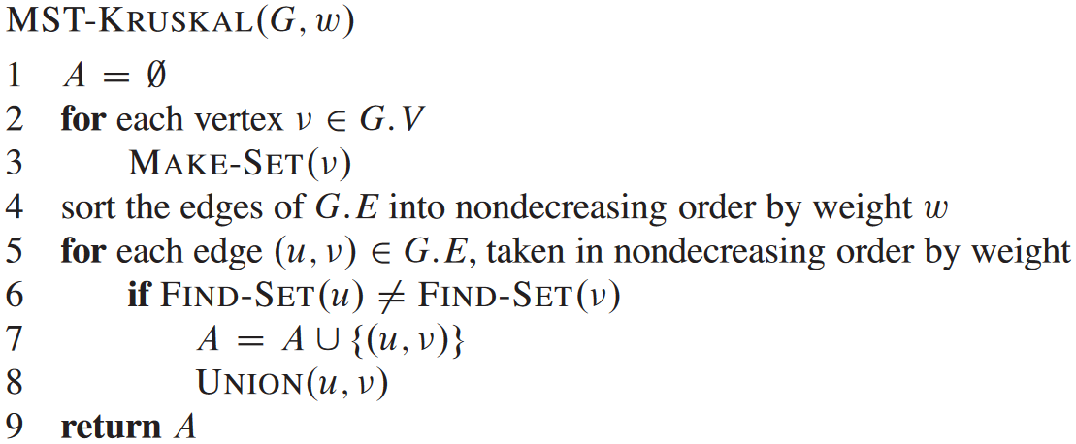
Kruskal’s Algorithm for MST
MAKE-SET(x) creates a new set whose only member (and thus representative) is x. Since the sets are disjoint, we require that x not already be in some other set.
FIND-SET(x) returns a pointer to the representative of the (unique) set containing x.
UNION(x,y) unites the dynamic sets that contain x and y

Slide 59



Exercises – Home Work
The complexity for the Kruskal’s algorithm is in $θ(a log⁡n)$where $a$ is total number of edges and $n$is the total number of nodes in the graph $G$.
Write the kruskal’s Algorithm to find out Minimum Spanning Tree. Apply the same and find MST for the graph given below.
$$1.$$
$$2.$$
3
A
1
10
F
C
3
A
B
C
4
4
3
7
2
4
5
8
5
B
6
D
E
F
G
4
D
H
4
2
3
2
8
1
9
3
G
E
3
H

Slide 60

Prim’s Algorithm
In Prim's algorithm, the minimum spanning tree grows in a natural way, starting from an arbitrary root.
At each stage we add a new branch to the tree already constructed; the algorithm stops when all the nodes have been reached.
The complexity for the Prim’s algorithm is $θ(n^{2})$ where $n$ is the total number of nodes in the graph $G$.

Slide 61
Prim’s Algorithm for MST – Example 1
Select an arbitrary node.
Step:1
Node - Set B | Edges
1
1
1
2
2
3
4
6
4
5
6
4
5
6
3
8
7
4
3
7

Slide 62
Prim’s Algorithm for MST – Example 1
Find an edge with minimum weight.
Step:2
Node - Set B | Edges
1
1
1
2
2
3
{1, 2}, {1, 4}
4
6
4
5
6
1, 2
{1, 4}, {2, 3} {2, 4}, {2, 5}
1, 2, 3
{1,4}, {2,4}, {2,5}, {3,5}, {3,6}
4
5
6
3
8
1, 2, 3, 4
{2,4} {2,5} {3,5} {3,6} {4,5} {4,7}
7
4
3
{2,4} {2,5} {3,5} {3,6} {4,7} {5,6} {5,7}
1, 2, 3, 4, 5
7
1, 2, 3, 4, 5, 7
{2,4} {2,5} {3,5} {3,6} {5,6} {5,7} {6,7}
1, 2, 3, 4, 5, 6, 7

Slide 63
Prim’s Algorithm for MST – Example 1
Step:3
The minimum spanning tree for the given graph.
Node | Edges
1
1, 2 | {1, 2}
1, 2, 3 | {2, 3}
1, 2, 3, 4 | {1, 4}
1, 2, 3, 4, 5 | {4, 5}
1, 2, 3, 4, 5, 7 | {4, 7}
1, 2, 3, 4, 5, 6, 7 | {6, 7}
1
1
2
2
3
4
4
5
6
3
4
3
7
Total Cost = 17

Slide 64
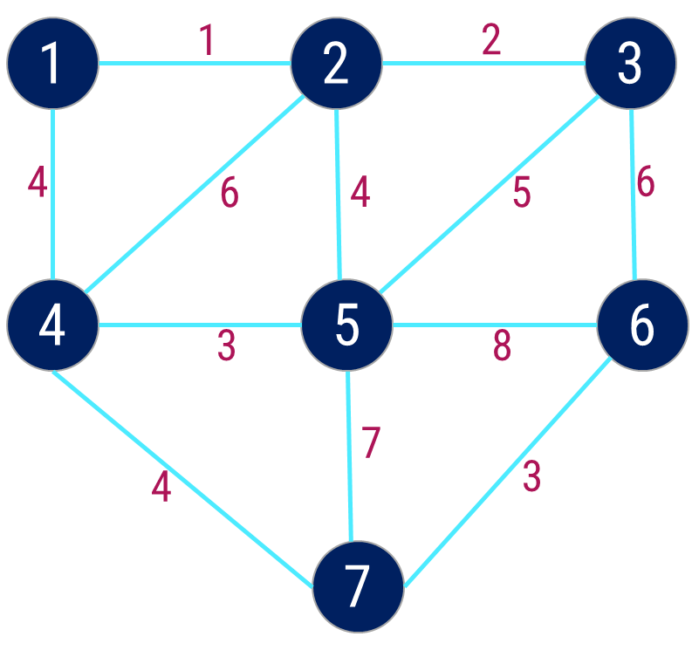
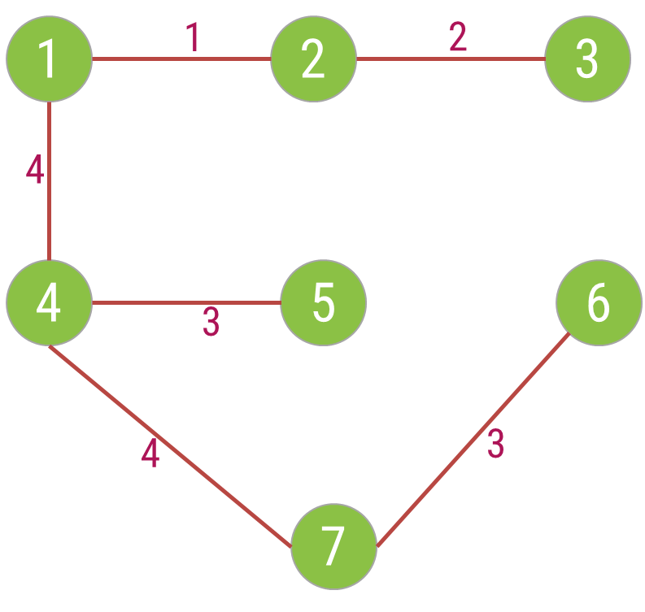
Prim’s Algorithm – Example 1
Cost = 17
Step | Edge Selected {u, v} | Set B | Edges Considered
Init. | - | {1} | --
1 | {1, 2} | {1,2} | {1,2} {1,4}
2 | {2, 3} | {1,2,3} | {1,4} {2,3} {2,4} {2,5}
3 | {1, 4} | {1,2,3,4} | {1,4} {2,4} {2,5} {3,5} {3,6}
4 | {4, 5} | {1,2,3,4,5} | {2,4} {2,5} {3,5} {3,6} {4,5} {4,7}
5 | {4, 7} | {1,2,3,4,5,7} | {2,4} {2,5} {3,5} {3,6} {4,7} {5,6} {5,7}
6 | {6,7} | {1,2,3,4,5,6,7} | {2,4} {2,5} {3,5} {3,6} {5,6} {5,7} {6,7}

Slide 65
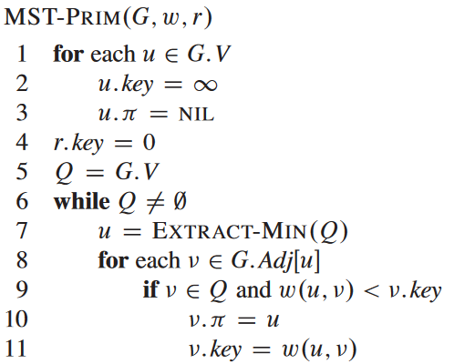
Prim’s Algorithm

Slide 66


Exercises – Home Work
Write the Prim’s Algorithm to find out Minimum Spanning Tree. Apply the same and find MST for the graph given below.
$$1.$$
$$2.$$
3
A
1
10
F
C
3
A
B
C
4
4
3
7
2
4
5
8
5
B
6
D
E
F
G
4
D
H
4
2
3
2
8
1
9
3
G
E
3
H

Slide 67
Single Source Shortest Path – Dijkstra’s Algorithm

Slide 68
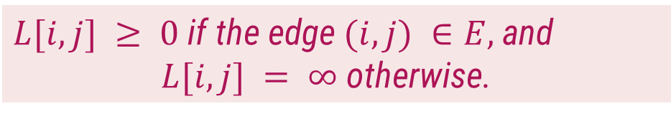
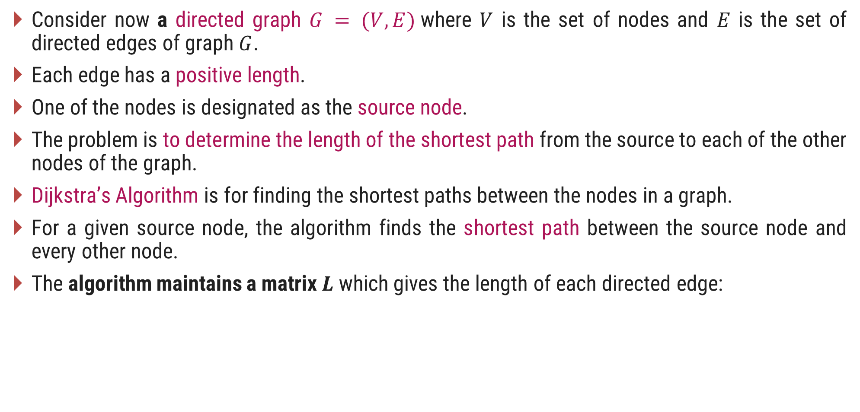
Introduction
Consider now a directed graph $G = (V,E)$where $V$ is the set of nodes and $E$ is the set of directed edges of graph $G$.
Each edge has a positive length.
One of the nodes is designated as the source node.
The problem is to determine the length of the shortest path from the source to each of the other nodes of the graph.
Dijkstra’s Algorithm is for finding the shortest paths between the nodes in a graph.
For a given source node, the algorithm finds the shortest path between the source node and every other node.
The algorithm maintains a matrix $L$ which gives the length of each directed edge:
$L[i, j] ≥ 0$ if the edge $(i, j) ∈E,$and
$L[i, j] = ∞$otherwise.

Slide 69
Dijkstra’s Algorithm - Example
1
Single source shortest path algorithm
10
50
5
2
100
30
Source node = 1
10
5
Step
v
C
2
3
4
5
20
Init.
-
{2, 3, 4, 5}
50
30
100
10
4
3
50
1
5
{2, 3, 4}
50
30
20
10
Is there path from 1 - 5 - 2
No
Compare cost of 1–5–4 (20) and 1–4 (100)
Is there path from 1 - 5 - 4
Is there path from 1 - 5 - 3
Yes

Slide 70
Dijkstra’s Algorithm - Example
1
Single source shortest path algorithm
10
50
5
2
100
30
Source node = 1
10
5
Step
v
C
2
3
4
5
20
Init.
-
{2, 3, 4, 5}
50
30
100
10
4
3
50
1
5
{2, 3, 4}
50
30
20
10
2
4
{2, 3}
40
30
20
10
Is there path from 1 - 4 - 2
Yes
Compare cost of 1–4–2 (40) and 1–2(50)
Compare cost of 1–4–3 (70) and 1–3 (30)
Is there path from 1 - 4 - 5
No
Is there path from 1 - 4 - 3

Slide 71
Dijkstra’s Algorithm - Example
1
Single source shortest path algorithm
10
50
5
2
100
30
Source node = 1
10
5
Step
v
C
2
3
4
5
20
Init.
-
{2, 3, 4, 5}
50
30
100
10
4
3
50
1
5
{2, 3, 4}
50
30
20
10
2
4
{2, 3}
40
30
20
10
3
3
{2}
35
30
20
10
Is there path from 1 - 3 - 2
Yes
Compare cost of 1–3–2 and 1–2
Is there path from 1 - 3 - 4
No
Is there path from 1 - 3 - 5

Slide 72
Exercises – Home Work
Write Dijkstra’s Algorithm for shortest path. Use the algorithm to find the shortest path from the following graph.
$$1.$$
$$2.$$
A
2
B
B
2
D
10
4
1
3
10
A
1
4
8
7
9
C
2
D
2
E
3
2
5
8
4
6
C
E
F
1
G

Slide 73
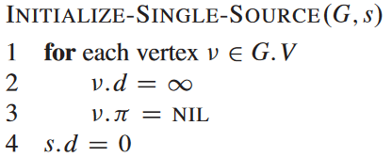
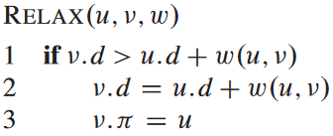
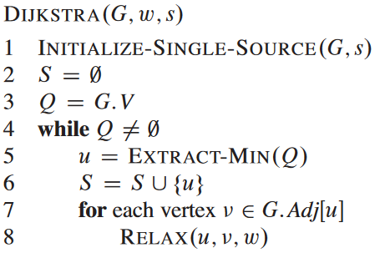
Dijkstra’s Algorithm
G=(V,E), w=weights, s= source
 | S | A | B | C | D
v.d
v.π
A
B
1
10
3
9
S
2
4
6
5
7
2
D
C

Slide 74
Thank You!

